Slide 1
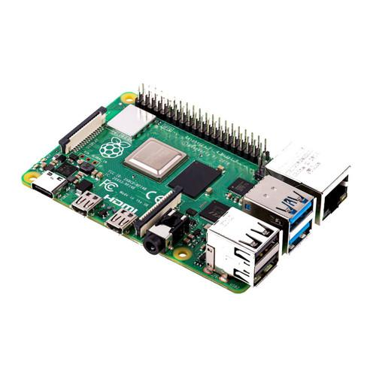
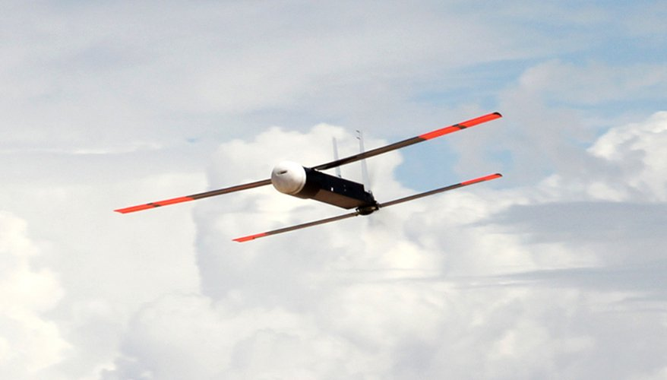
Army Research Lab Web Interface
Team 313: Jose Hernandez, Francisco Malave, Ashok Phatak,
Andrew Poirier, Anaice Soares-Concepcion, Yosuf Young
Faculty Advisor: Jerris Hooker, Ph.D. Sponsor: James Humann, Ph.D.
Motivation & Objective
Final Design
Software & Hardware
The motivation behind this project was to improve a pre-existing system to control and collect data from a drone.
The objective of this project is to design,
develop, and implement a user-friendly web interface to control and collect data from a drone via a Raspberry Pi
Figure 1: Home webpage
Figure 5: Robot Operating System (ROS2), software implemented
Summary
We developed a user-friendly web interface that allows the user to control certain aspects of the design as well as access certain data and readings
We simplified the basic functions of the drone UI
We implemented security measures to ensure a safe and secure work environment.
Figure 2: Download Files webpage
Figure 6: Raspberry Pi 4 Model B
Figure 7: Raytheon Coyote, drone similar to drone implemented
Future Work
Figure 3: System Settings webpage
Plenty of work can still be done in terms of optimizing the Raspberry Pi hardware itself, specifically the temperature for the Raspberry Pi
Many of these improvements involve improving the speed at which ROS operates with the project website
Future work and design improvement can go towards the networking capabilities of the
interface
Acknowledgment
Special thanks to the National Science Innovation Network (NSIN), and The U.S. Army Combat Capabilities Development Command (DEVCOM). Specifically, we would like to thank our Sponsor, Dr. James Humann, for his guidance through the design process.
Figure 4: Software Settings webpage
Notes:
ALL TEXT BOXES ARE 18.49” by 10.7” wide

